Slide 1


Docker and the Container Ecosystem
09
PART III · CONTAINERS AND LIGHTWEIGHT VIRTUALIZATION
CHAPTER 9 · WEEK 7
From Hypervisors to the Cloud-Native Stack
LECTURER
Dr. Mustafa Hameed
THE ISLAMIA UNIVERSITY OF BAHAWALPUR
Bahawalpur, Pakistan
Department of Information Technology · BSIT · Fall 2026
Notes:
Chapter 9: Docker and the Container Ecosystem. Part 3 — Containers and Lightweight Virtualization. Week 7: From machines to containers; Docker. Handout pages 69–76.

Slide 2

Where this chapter sits
THE COURSE
PART I
PART II
PART III
PART IV
PART V
PART VI
1
2
3
4
5
6
7
8
9
10
11
12
13
14
15
16
17
18
19
20
21
22
23
Docker and the Container Ecosystem
BUILDS ON
USED LATER IN
Ch 8 From Virtual Machines to Containers
Ch 10 Container Orchestration with Kubernetes
Ch 19 Security in Virtualized Environments
Virtual Systems and Services · Chapter 9 · Docker and the Container Ecosystem
Handout p. 69 2
Notes:
Place the chapter. Before you start: Chapter 8 entire — namespaces, cgroups and especially overlayfs, since an image is layers and a layer is an overlayfs directory. The lab in that chapter built a container by hand; this one is about everything that was missing from it.

Slide 3

What you will be able to do
LEARNING OUTCOMES
By the end of this chapter you will be able to:
1
Explain what Docker added to the kernel features of Chapter 8, and why that — rather than isolation — is what changed the industry.
2
Describe an image as a stack of content-addressed layers plus a manifest, and explain what a digest guarantees.
3
Name the components of the OCI runtime stack and say what each one does.
4
Order the instructions in a Dockerfile so that the build cache is not needlessly invalidated, and quantify what the wrong order costs.
5
Write a Dockerfile that is multi-stage, pinned and non-root, and justify each of those three properties.
Virtual Systems and Services · Chapter 9 · Docker and the Container Ecosystem
Handout p. 69 3
Notes:
Read these out: they are the chapter's contract with the room. Each click adds one.

Slide 4

Vocabulary for this chapter
KEY TERMS
image
layer
manifest
image index
digest
content addressing
tag
registry
Dockerfile
build cache
cache invalidation
multi-stage build
distroless
OCI image specification
OCI runtime specification
containerd
runc
shim
BuildKit
SBOM
volume
Each term is defined where it first matters — not here.
Virtual Systems and Services · Chapter 9 · Docker and the Container Ecosystem
Handout p. 69 4
Notes:
Do not define these now; they arrive one at a time. This slide is for the students' notes. Terms: image; layer; manifest; image index; digest; content addressing; tag; registry; Dockerfile; build cache; cache invalidation; multi-stage build; distroless; OCI image specification; OCI runtime specification; containerd; runc; shim; BuildKit; SBOM; volume.

Slide 5
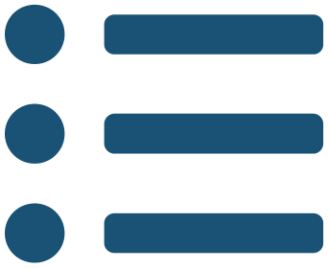
In this chapter
IN THIS CHAPTER
9.1
What Docker Actually Added
p. 69 ›
9.2
Images, Layers and Digests
p. 70 ›
9.3
The OCI Stack
p. 70 ›
9.4
The Build Cache, and the Mistake Everyone Makes
p. 71 ›
9.5
A Dockerfile That Holds Up
p. 72 ›
Virtual Systems and Services · Chapter 9 · Docker and the Container Ecosystem
Handout pp. 69–76 5
Notes:
The route through the chapter. Each row is a link: click it to jump to that section in the slide show.

Slide 6
What Docker Actually Added
SECTION 1 OF 5
9.1
9.1 What Docker Actually Added
9.2 Images, Layers and Digests
9.3 The OCI Stack
9.4 The Build Cache, and the Mistake Everyone Makes
9.5 A Dockerfile That Holds Up
Virtual Systems and Services · Chapter 9
Handout §9.1 6
Notes:
Pause. Name the question this section answers.

Slide 7
What Docker Actually Added
IN BRIEF
Docker’s 2013 release added almost nothing to the kernel. What it added was a format and a workflow:
• a declarative build file producing a reproducible artefact;
• an image format that is layered, so sharing and incremental transfer are free;
• a registry protocol, so an image could be published and pulled by name;
• one command to run any of it.
Virtual Systems and Services · Chapter 9 · Docker and the Container Ecosystem
§9.1 · Handout p. 69 7
Notes:
Everything in Chapter 8 existed before Docker. Namespaces had been in Linux for a decade, cgroups for six years, and LXC had been packaging both since 2008. Google was running billions of containers a week.

Slide 8

The Problem It Solved Was Not Isolation
CONCEPT
LXC already isolated things perfectly well. What it did not do was let a developer hand an operator something that would behave identically on both machines.
The before-and-after is the whole story. Before: a wiki page saying “install Python 3.9, these fourteen packages, this version of libxml2, set these three environment variables” — a procedure that worked on the author’s laptop and drifted everywhere else. After: a file that is the procedure, executed in a defined base, producing an artefact identified by a hash that either matches or does not.
This is encapsulation — the third motive of Chapter 1 — applied to an application rather than a machine, and it is why the format won against better-engineered rivals. The density of Chapter 8 was discovered to be a bonus afterwards.
Virtual Systems and Services · Chapter 9 · Docker and the Container Ecosystem
§9.1 · Handout p. 69 8
Notes:
Read the box aloud, then ask for an example from the room before moving on.

Slide 9

Content Addressing, Digest and Tag
DEFINITION
Every layer, configuration and manifest is identified by a digest: the SHA-256 of the bytes themselves. Content addressing has three consequences the whole ecosystem rests on:
• Deduplication is automatic. Two images sharing a base share its layer digest, so it is stored and transferred once.
• Integrity is free. If the bytes are intact the digest matches; if anything changed, it does not.
• Identity is exact. ubuntu@sha256:9b8c… is one specific image, for ever.
A tag — ubuntu:22.04 — is not identity. It is a mutable pointer that the publisher may move whenever they like, and routinely does. Two builds a week apart from the same tag may use different bytes, which is precisely the reproducibility problem Docker was invented to solve, reappearing one level up. Pin digests where reproducibility matters.
Virtual Systems and Services · Chapter 9 · Docker and the Container Ecosystem
§9.2 · Handout p. 70 9
Notes:
An image is not a file. It is a manifest — a small JSON document — listing a configuration object and an ordered set of layers, each referenced by the SHA-256 hash of its contents.

Slide 10
The OCI Stack
SECTION 3 OF 5
9.3
9.1 What Docker Actually Added
9.2 Images, Layers and Digests
9.3 The OCI Stack
9.4 The Build Cache, and the Mistake Everyone Makes
9.5 A Dockerfile That Holds Up
Virtual Systems and Services · Chapter 9
Handout §9.3 10
Notes:
Pause. Name the question this section answers.

Slide 11
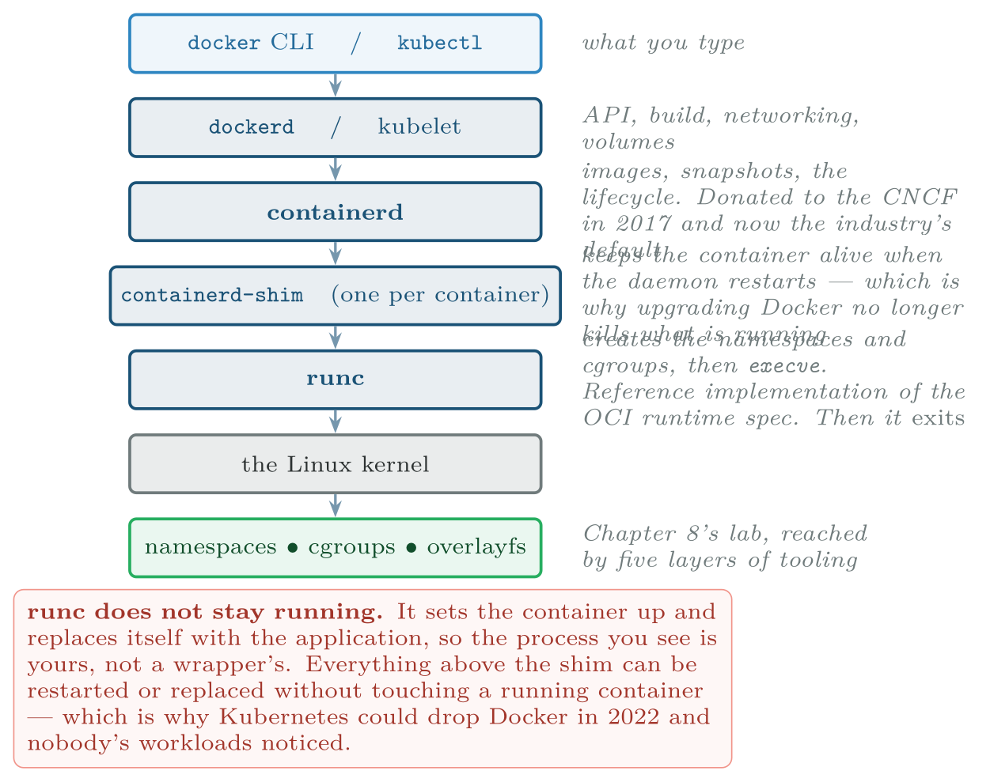
The runtime stack
FIGURE 9.1
Each layer was split out of the one above it as the ecosystem matured; the bottom two rows are the only ones that are not replaceable.
Virtual Systems and Services · Chapter 9 · Docker and the Container Ecosystem
§9.3 · Handout p. 70 11
Notes:
By 2015 the format mattered enough that it needed an owner who was not a company. Docker donated it, and the Open Container Initiative now maintains three specifications — image, runtime and distribution — which is why containers built with Docker run under containerd, CRI-O, Podman and Kubernetes without anyone negotiating. The implementation split up at the same time.
Figure 9.1 (handout p. 71): The runtime stack. Each layer was split out of the one above it as the ecosystem matured; the bottom two rows are the only ones that are not replaceable.

Slide 12

“Kubernetes deprecated Docker” was widely misread
WATCH OUT
In 2022 Kubernetes removed dockershim, the adapter that let the kubelet drive dockerd. Headlines announced that Docker was dead, and a great many teams rebuilt images they did not need to rebuild.
What was removed was one adapter. Kubernetes now talks to containerd directly — which is what dockerd was talking to anyway, so a layer was deleted rather than a capability. Images built with Docker are OCI images and run unchanged, because that is what standardising the format was for.
Worth remembering as a general lesson: in this ecosystem the format is the durable thing and the tooling is not.
Virtual Systems and Services · Chapter 9 · Docker and the Container Ecosystem
§9.3 · Handout p. 70 12
Notes:
Read the box aloud, then ask for an example from the room before moving on.

Slide 13
The Build Cache, and the Mistake Everyone Makes
SECTION 4 OF 5
9.4
9.1 What Docker Actually Added
9.2 Images, Layers and Digests
9.3 The OCI Stack
9.4 The Build Cache, and the Mistake Everyone Makes
9.5 A Dockerfile That Holds Up
Virtual Systems and Services · Chapter 9
Handout §9.4 13
Notes:
Pause. Name the question this section answers.

Slide 14
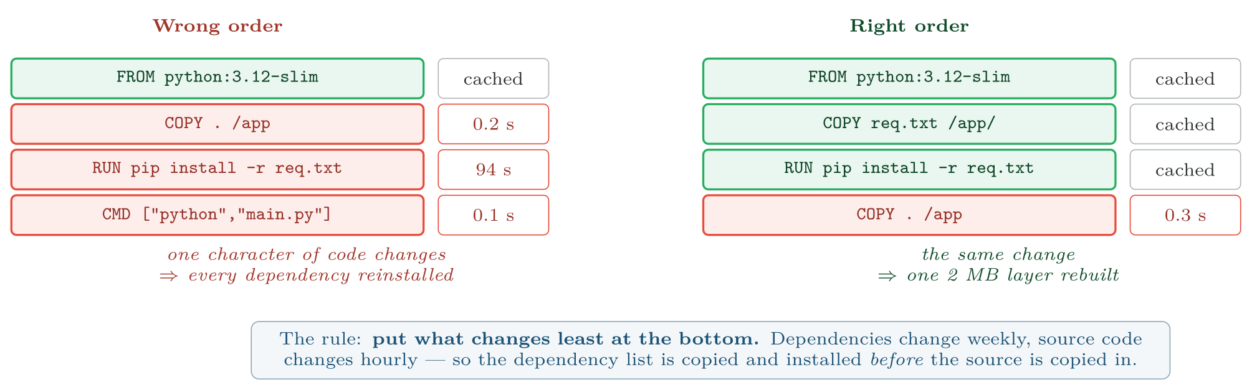
The same four instructions in two orders
FIGURE 9.2
Nothing else differs, and the rebuild costs differ by a factor of 300.
Virtual Systems and Services · Chapter 9 · Docker and the Container Ecosystem
§9.4 · Handout p. 71 14
Notes:
Each instruction in a Dockerfile produces a layer. On rebuild, Docker reuses a cached layer if the instruction and all the layers beneath it are unchanged — and crucially, once one layer is invalidated, every layer above it is rebuilt too. That single rule decides whether a build takes four seconds or ninety-five, and almost every slow build in existence gets it wrong the same way.
Figure 9.2 (handout p. 71): The same four instructions in two orders. Nothing else differs, and the rebuild costs differ by a factor of 300.

Slide 15

What the Wrong Order Costs a Team
WORKED EXAMPLE
A team of six rebuilds this image about 30 times a day between them. Measure the cost of the left-hand order against the right-hand one.
Step 1 — per-build time. From the figure:
Step 2 — per day.
Step 3 — the bytes pushed. A rebuilt layer must be uploaded; a cached one need not. The dependency layer is 180 MB and the application layer is 2 MB:
Virtual Systems and Services · Chapter 9 · Docker and the Container Ecosystem
§9.4 · Handout p. 71 15
Notes:
Each click adds one step of the working. Ask for the next number before you reveal it.

Slide 16
What the Wrong Order Costs a Team (continued)
WORKED EXAMPLE
Step 4 — and the pulls. Every deployment target pulls what changed. With 12 nodes and 30 deployments:
Step 5 — read the result. Reordering two lines saves 47 minutes of engineer waiting, 5.3 GB of upload and 64 GB of download, every day. Over a working year that is roughly 190 hours and 17 TB.
What the arithmetic does not capture. The 47 minutes are not spread evenly: they are 94 seconds at a time, which is exactly long enough to lose concentration and not long enough to do anything else. That cost is larger than the number, and it is the real argument for getting the order right.
Virtual Systems and Services · Chapter 9 · Docker and the Container Ecosystem
§9.4 · Handout p. 71 16
Notes:
Each click adds one step of the working. Ask for the next number before you reveal it.

Slide 17
A Dockerfile That Holds Up
SECTION 5 OF 5
9.5
9.1 What Docker Actually Added
9.2 Images, Layers and Digests
9.3 The OCI Stack
9.4 The Build Cache, and the Mistake Everyone Makes
9.5 A Dockerfile That Holds Up
Virtual Systems and Services · Chapter 9
Handout §9.5 17
Notes:
Pause. Name the question this section answers.

Slide 18
Multi-Stage: Build Tools Are Not Runtime Dependencies
CONCEPT
A compiler, a package manager and a full toolchain are needed to build and are liabilities at run time: they are weight, and they are attack surface for anyone who gets a shell.
A multi-stage build uses one stage with the toolchain and a second containing only the artefact:
• A Go service: builder stage with the Go toolchain, about 900 MB; final stage FROM scratch with one static binary, about 15 MB. A 60:1 reduction.
• A Python service: compilers for the C extensions in the builder stage; only the slim base and the installed packages in the final one. Typically 1.1 GB down to 210 MB.
Distroless images go further — a language runtime and no shell, no package manager, no ls. An attacker with code execution has nothing to run. The cost is that you cannot exec into it to debug, which is a real operational trade and not everyone’s.
Virtual Systems and Services · Chapter 9 · Docker and the Container Ecosystem
§9.5 · Handout p. 72 18
Notes:
Three properties, each with a reason.

Slide 19
Pin the base, and know what :latest promises
WATCH OUT
FROM ubuntu:latest promises nothing. It resolves to whatever the publisher last pushed, so a build that worked this morning may not this afternoon, and the failure appears in CI with no change in your repository.
FROM ubuntu:22.04 is better and is still a moving pointer — the tag is republished with security updates, which you usually want. FROM ubuntu@sha256:9b8c… is exact and never changes, which means you must update it deliberately to get security fixes.
The usual resolution: pin digests in production manifests, and run an automated job that proposes digest updates as reviewable changes. Choosing between reproducibility and patching by accident is the only wrong answer.
Virtual Systems and Services · Chapter 9 · Docker and the Container Ecosystem
§9.5 · Handout p. 72 19
Notes:
Read the box aloud, then ask for an example from the room before moving on.

Slide 20
Do Not Run as Root
CONCEPT
A container process running as UID 0 is, without a user namespace (Chapter 8), really root — and a kernel bug then yields the host rather than a container.
USER in the Dockerfile costs nothing and removes the whole class. Combine it with a read-only root filesystem and dropped capabilities at run time, and an attacker who achieves code execution has an unprivileged process in a filesystem it cannot write. Chapter 19 covers the rest of the hardening set.
Virtual Systems and Services · Chapter 9 · Docker and the Container Ecosystem
§9.5 · Handout p. 72 20
Notes:
Read the box aloud, then ask for an example from the room before moving on.

Slide 21

Common pitfalls
COMMON PITFALLS
✕
Copying source before installing dependencies. The worked example above. Reordering two lines is the single highest-return change available in most repositories.
✕
Running apt-get update in a separate layer from install. The update layer caches, so a later install can fetch a package list months out of date. Always one RUN.
✕
Leaving secrets in a build. Deleting a file in a later layer does not remove it — the earlier layer still contains it, and anyone who pulls the image can read it. Use build secrets or a mount.
✕
Treating a tag as an identity. It is a mutable pointer. Only a digest identifies an image.
✕
Storing data in the container. The writable layer dies with the container and copy-up is slow. Use a volume.
✕
Equating image size with security. A 50 MB image with an unpatched library is worse than a 400 MB patched one. Size reduces attack surface and transfer cost; it does not replace patching.
Virtual Systems and Services · Chapter 9 · Docker and the Container Ecosystem
§9.5 · Handout p. 72 21
Notes:
For each pitfall, ask who has seen it happen. One real story beats five bullets.

Slide 22

Try it yourself: Measuring the Build Cache, and Fixing It
TRY IT YOURSELF
Builds the same application both ways and measures the difference; then makes it multi-stage and non-root. Needs Docker. Expect thirty minutes.
WHAT YOU WILL DO
1. A small application with real dependencies.
2. The wrong order: source copied before dependencies.
3. The right order: dependency list first, then source.
4. Change one character of source and time both rebuilds.
5. Look at the layers, and at what is shared.
6. Multi-stage and non-root.
7. Prove it is not running as root, and cannot write its root.
8. A secret deleted in a later layer is still in the image.
9. Tear down.
THIS WEEK'S LAB
WHAT YOU WILL RUN
Week 7: Build a container by hand; then measure the build cache
1 listing, 84 lines of Shell
Virtual Systems and Services · Chapter 9 · Docker and the Container Ecosystem
§9.5 · Handout p. 72 22
Notes:
Builds the same application both ways and measures the difference; then makes it multi-stage and non-root. Needs Docker. Expect thirty minutes.

Slide 23
Measuring the Build Cache, and Fixing It
LAB · STEP 1 OF 10
Set-up
Shell
1
2
3
4
#!/usr/bin/env bash
# ch09_build.sh -- the build cache, measured, then a sound image.
set -euo pipefail
mkdir -p ~/vsapp && cd ~/vsapp
Virtual Systems and Services · Chapter 9 · Docker and the Container Ecosystem
§9.5 · Handout p. 72 23
Notes:
Step 1: Set-up. Read the code aloud; ask what each line would print before running it.

Slide 24
Measuring the Build Cache, and Fixing It
LAB · STEP 2 OF 10
A small application with real dependencies.
Shell
6
7
8
9
10
11
12
13
14
15
16
17
18
# --- 1. A small application with real dependencies. --------------------
cat > requirements.txt <<'REQ'
flask==3.0.3
requests==2.32.3
REQ
cat > main.py <<'PY'
from flask import Flask
app = Flask(__name__)
@app.route("/")
def index():
return "virtual systems and services\n"
PY
Virtual Systems and Services · Chapter 9 · Docker and the Container Ecosystem
§9.5 · Handout p. 72 24
Notes:
Step 2: A small application with real dependencies.. Read the code aloud; ask what each line would print before running it.

Slide 25
Measuring the Build Cache, and Fixing It
LAB · STEP 3 OF 10
The wrong order: source copied before dependencies.
Shell
20
21
22
23
24
25
26
27
28
# --- 2. The wrong order: source copied before dependencies. -----------
cat > Dockerfile.wrong <<'DF'
FROM python:3.12-slim
WORKDIR /app
COPY . /app
RUN pip install --no-cache-dir -r requirements.txt
CMD ["python", "-m", "flask", "run", "--host=0.0.0.0"]
DF
docker build -q -f Dockerfile.wrong -t vsapp:wrong . > /dev/null
Virtual Systems and Services · Chapter 9 · Docker and the Container Ecosystem
§9.5 · Handout p. 72 25
Notes:
Step 3: The wrong order: source copied before dependencies.. Read the code aloud; ask what each line would print before running it.

Slide 26
Measuring the Build Cache, and Fixing It
LAB · STEP 4 OF 10
The right order: dependency list first, then source.
Shell
30
31
32
33
34
35
36
37
38
39
# --- 3. The right order: dependency list first, then source. ----------
cat > Dockerfile.right <<'DF'
FROM python:3.12-slim
WORKDIR /app
COPY requirements.txt /app/
RUN pip install --no-cache-dir -r requirements.txt
COPY . /app
CMD ["python", "-m", "flask", "run", "--host=0.0.0.0"]
DF
docker build -q -f Dockerfile.right -t vsapp:right . > /dev/null
Virtual Systems and Services · Chapter 9 · Docker and the Container Ecosystem
§9.5 · Handout p. 72 26
Notes:
Step 4: The right order: dependency list first, then source.. Read the code aloud; ask what each line would print before running it.

Slide 27
Measuring the Build Cache, and Fixing It
LAB · STEP 5 OF 10
Change one character of source and time both rebuilds.
Shell
41
42
43
44
45
46
# --- 4. Change one character of source and time both rebuilds. --------
sed -i 's/services/services!/' main.py
echo "=== wrong order ===" ; time docker build -q -f Dockerfile.wrong \
-t vsapp:wrong . > /dev/null
echo "=== right order ===" ; time docker build -q -f Dockerfile.right \
-t vsapp:right . > /dev/null
Virtual Systems and Services · Chapter 9 · Docker and the Container Ecosystem
§9.5 · Handout p. 72 27
Notes:
Step 5: Change one character of source and time both rebuilds.. Read the code aloud; ask what each line would print before running it.

Slide 28
Measuring the Build Cache, and Fixing It
LAB · STEP 6 OF 10
Look at the layers, and at what is shared.
Shell
48
49
50
51
52
# --- 5. Look at the layers, and at what is shared. --------------------
docker history vsapp:right --format '{{.Size}}\t{{.CreatedBy}}' | head -8
docker image inspect vsapp:right \
--format '{{json .RootFS.Layers}}' | tr ',' '\n'
# Both images share the python:3.12-slim layers: content addressing at work.
Virtual Systems and Services · Chapter 9 · Docker and the Container Ecosystem
§9.5 · Handout p. 72 28
Notes:
Step 6: Look at the layers, and at what is shared.. Read the code aloud; ask what each line would print before running it.

Slide 29
Measuring the Build Cache, and Fixing It
LAB · STEP 7 OF 10
Multi-stage and non-root.
Shell
54
55
56
57
58
59
60
61
62
63
64
65
66
67
68
69
70
71
# --- 6. Multi-stage and non-root. -------------------------------------
cat > Dockerfile.good <<'DF'
FROM python:3.12-slim AS build
WORKDIR /app
COPY requirements.txt /app/
RUN pip install --no-cache-dir --target=/deps -r requirements.txt
FROM python:3.12-slim
RUN useradd --create-home --uid 10001 app
WORKDIR /app
COPY --from=build /deps /deps
COPY --chown=app:app . /app
ENV PYTHONPATH=/deps
USER app
CMD ["python", "-m", "flask", "run", "--host=0.0.0.0"]
DF
docker build -q -f Dockerfile.good -t vsapp:good . > /dev/null
docker images vsapp --format '{{.Tag}}\t{{.Size}}'
Virtual Systems and Services · Chapter 9 · Docker and the Container Ecosystem
§9.5 · Handout p. 72 29
Notes:
Step 7: Multi-stage and non-root.. Read the code aloud; ask what each line would print before running it.

Slide 30
Measuring the Build Cache, and Fixing It
LAB · STEP 8 OF 10
Prove it is not running as root, and cannot write its root.
Shell
73
74
75
# --- 7. Prove it is not running as root, and cannot write its root. ---
docker run --rm vsapp:good id
docker run --rm --read-only vsapp:good sh -c 'touch /nope' 2>&1 | tail -1
Virtual Systems and Services · Chapter 9 · Docker and the Container Ecosystem
§9.5 · Handout p. 72 30
Notes:
Step 8: Prove it is not running as root, and cannot write its root.. Read the code aloud; ask what each line would print before running it.

Slide 31
Measuring the Build Cache, and Fixing It
LAB · STEP 9 OF 10
A secret deleted in a later layer is still in the image.
Shell
77
78
79
80
81
# --- 8. A secret deleted in a later layer is still in the image. ------
printf 'FROM alpine\nRUN echo hunter2 > /k && rm /k\n' > Dockerfile.leak
docker build -q -f Dockerfile.leak -t vsapp:leak . > /dev/null
docker save vsapp:leak | tar -xO 2>/dev/null | grep -ac hunter2 || \
echo "search the layer tarballs: the secret is in one of them"
Virtual Systems and Services · Chapter 9 · Docker and the Container Ecosystem
§9.5 · Handout p. 72 31
Notes:
Step 9: A secret deleted in a later layer is still in the image.. Read the code aloud; ask what each line would print before running it.

Slide 32
Measuring the Build Cache, and Fixing It
LAB · STEP 10 OF 10
Tear down.
Shell
83
84
# --- 9. Tear down. ----------------------------------------------------
docker rmi -f vsapp:wrong vsapp:right vsapp:good vsapp:leak || true
Virtual Systems and Services · Chapter 9 · Docker and the Container Ecosystem
§9.5 · Handout p. 72 32
Notes:
Step 10: Tear down.. Read the code aloud; ask what each line would print before running it.

Slide 33
What the lab shows
TRY IT YOURSELF
What to notice. Step 4 gives you the worked example’s two numbers on your own machine. Step 8 is the one worth remembering: rm in a Dockerfile removes a file from the view, not from the image, and everything you ever put in a layer is still there for whoever pulls it.
Virtual Systems and Services · Chapter 9 · Docker and the Container Ecosystem
§9.5 · Handout p. 72 33
Notes:
Read the box aloud, then ask for an example from the room before moving on.

Slide 34

An image is built from FROM node:20 on Monday and again on Friday with no repository changes, and the two behave differently. Explain how, and give the change that prevents it.
CHECKPOINT 1 OF 3
Discuss with the person next to you, then advance.
Virtual Systems and Services · Chapter 9 · Docker and the Container Ecosystem
Handout p. 76 · answers in Appendix D 34
Notes:
Ask the room. Do not advance until someone commits to an answer.

Slide 35

An image is built from FROM node:20 on Monday and again on Friday with no repository changes, and the two behave differently. Explain how, and give the change that prevents it.
CHECKPOINT 1 OF 3 · ANSWER
node:20 is a tag, which is a mutable pointer. The publisher republished it during the week — a patch release, a new base layer — so Friday’s build used different bytes. The change that prevents it is to pin the digest: FROM node:20@sha256:…, which identifies exact content for ever. Pair it with an automated job that proposes digest updates as reviewable changes, so security fixes are still applied deliberately.
Virtual Systems and Services · Chapter 9 · Docker and the Container Ecosystem
Handout p. 76 · answers in Appendix D 35
Notes:
Answer (Appendix D): node:20 is a tag, which is a mutable pointer. The publisher republished it during the week — a patch release, a new base layer — so Friday’s build used different bytes. The change that prevents it is to pin the digest: FROM node:20@sha256:…, which identifies exact content for ever. Pair it with an automated job that proposes digest updates as reviewable changes, so security fixes are still applied deliberately.

Slide 36
A Dockerfile copies a private key, uses it to clone a repository, then deletes it in the same RUN. Is the key in the image? What if the delete is a separate RUN?
CHECKPOINT 2 OF 3
Discuss with the person next to you, then advance.
Virtual Systems and Services · Chapter 9 · Docker and the Container Ecosystem
Handout p. 76 · answers in Appendix D 36
Notes:
Ask the room. Do not advance until someone commits to an answer.

Slide 37
A Dockerfile copies a private key, uses it to clone a repository, then deletes it in the same RUN. Is the key in the image? What if the delete is a separate RUN?
CHECKPOINT 2 OF 3 · ANSWER
Same RUN: no. Only the layer’s final state is committed, and the key was deleted before the layer closed. Separate RUN: yes. The first layer contains the key, the second records its deletion, and both layers ship. Anyone who pulls the image can extract the earlier layer and read it. This is why secrets belong in build secrets or a mount, never in a layer at all.
Virtual Systems and Services · Chapter 9 · Docker and the Container Ecosystem
Handout p. 76 · answers in Appendix D 37
Notes:
Answer (Appendix D): Same RUN: no. Only the layer’s final state is committed, and the key was deleted before the layer closed. Separate RUN: yes. The first layer contains the key, the second records its deletion, and both layers ship. Anyone who pulls the image can extract the earlier layer and read it. This is why secrets belong in build secrets or a mount, never in a layer at all.

Slide 38
A team’s CI rebuilds a 1.2 GB image on every commit and deploys it to 40 nodes. Using the worked example’s method, estimate what reordering the Dockerfile would save per day in transfer alone, stating your assumptions.
CHECKPOINT 3 OF 3
Discuss with the person next to you, then advance.
Virtual Systems and Services · Chapter 9 · Docker and the Container Ecosystem
Handout p. 76 · answers in Appendix D 38
Notes:
Ask the room. Do not advance until someone commits to an answer.

Slide 39
A team’s CI rebuilds a 1.2 GB image on every commit and deploys it to 40 nodes. Using the worked example’s method, estimate what reordering the Dockerfile would save per day in transfer alone, stating your assumptions.
CHECKPOINT 3 OF 3 · ANSWER
Stating assumptions: say the dependency layer is 1.0 GB, the application layer 20 MB, and there are 20 builds a day. Wrong order: each build rebuilds and pushes about 1.02 GB, and 40 nodes pull it: 20 × 1.02 + 40 × 20 × 1.02 ≈ 836 GB a day. Right order: only the 20 MB layer changes: 20 × 0.02 + 40 × 20 × 0.02 = 16.4 GB a day. A saving of roughly 820 GB a day in transfer alone, before counting the build time.
Virtual Systems and Services · Chapter 9 · Docker and the Container Ecosystem
Handout p. 76 · answers in Appendix D 39
Notes:
Answer (Appendix D): Stating assumptions: say the dependency layer is 1.0 GB, the application layer 20 MB, and there are 20 builds a day. Wrong order: each build rebuilds and pushes about 1.02 GB, and 40 nodes pull it: 20 × 1.02 + 40 × 20 × 1.02 ≈ 836 GB a day. Right order: only the 20 MB layer changes: 20 × 0.02 + 40 × 20 × 0.02 = 16.4 GB a day. A saving of roughly 820 GB a day in transfer alone, before counting the build time.

Slide 40

What to take away
CHAPTER SUMMARY
1
Docker added a build file, a layered image format, a registry protocol and one command — not isolation, which already existed. The problem it solved was reproducible delivery.
2
An image is a manifest plus content-addressed layers. A digest is identity and integrity; a tag is a mutable pointer and neither.
3
The OCI specifications made the format portable, which is why the tooling could be replaced underneath it without breaking anything.
4
The runtime stack is CLI, daemon, containerd, shim, runc, kernel. runc exits after setting the container up; the shim is why restarting the daemon does not kill running containers.
5
A cache miss invalidates every layer above it. Put what changes least at the bottom: dependency lists before source. The wrong order cost the worked example’s team 47 minutes and 70 GB a day.
6
Multi-stage, pinned and non-root are the three properties a Dockerfile should have. A file deleted in a later layer is still in the image.
Virtual Systems and Services · Chapter 9 · Docker and the Container Ecosystem
Handout p. 76 40
Notes:
Ask the room to say each takeaway before you reveal it.

Slide 41

Quick check 1 of 2
REVIEW · MULTIPLE CHOICE
A digest identifies an image by:
A
its tag
B
the SHA-256 of its contents
C
its creation date
D
its registry URL
Virtual Systems and Services · Chapter 9 · Docker and the Container Ecosystem
Handout p. 76 41
Notes:
Take a show of hands for each option before discussing. (The handout does not print MCQ answers.)

Slide 42
Quick check 2 of 2
REVIEW · MULTIPLE CHOICE
runc, after setting up a container:
exits, having replaced itself with the application
A
supervises it until exit
B
becomes the container’s PID 1 wrapper
C
D
restarts the daemon
Virtual Systems and Services · Chapter 9 · Docker and the Container Ecosystem
Handout p. 76 42
Notes:
Take a show of hands for each option before discussing. (The handout does not print MCQ answers.)

Slide 43
For your notebook
REVIEW QUESTIONS
SHORT
State the build-cache rule in one sentence, and give the ordering principle that follows from it.
SHORT
Explain why a secret removed in a later layer is still recoverable from the image.
SHORT
Give the two reasons a multi-stage build is preferred, and the operational cost of going all the way to distroless.
APPLIED
You inherit a repository whose image is 1.4 GB, builds in four minutes, runs as root and uses FROM python:latest. Write the four changes you would make in priority order, with the measurable improvement you expect from each.
APPLIED
A regulated client requires that any deployed image can be reproduced exactly two years later. Describe what you would pin, what you would store, and what you would automate so that security patching still happens.
Virtual Systems and Services · Chapter 9 · Docker and the Container Ecosystem
Handout p. 76 43
Notes:
Set these for independent study. Model answers are not printed in the handout.

Slide 44
End of Chapter 9
09
NEXT
READ
Chapter 10 — Container Orchestration with Kubernetes
Handout Chapter 9, pages 69–76
THIS WEEK'S LAB
ASSESSMENT
Build a container by hand; then measure the build cache
Assignment 1 set
Virtual Systems and Services · Chapter 9 · Docker and the Container Ecosystem
44
Notes:
Close. NEXT: Chapter 10 — Container Orchestration with Kubernetes. READ: Handout Chapter 9, pages 69–76. THIS WEEK'S LAB: Build a container by hand; then measure the build cache. ASSESSMENT: Assignment 1 set.

